Slide 1

Note: The data and information in this document is reflective of a hypothetical situation and client. This document is to be used for KPMG Virtual Internship purposes only.
Sprocket Central Pty Ltd
Data analytics approach
[Division Name] - [Engagement Manager], [Senior Consultant], [Junior Consultant]

Slide 2
Note: The data and information in this document is reflective of a hypothetical situation and client. This document is to be used for KPMG Virtual Internship purposes only.
Agenda
Introduction
Data Exploration
Model Development
Interpretation

Slide 3
Note: The data and information in this document is reflective of a hypothetical situation and client. This document is to be used for KPMG Virtual Internship purposes only.
Introduction
Problem Statement : The company Specializes in high quality bike and accessories. The marketing teams wants to boost sales by identifying pattern and targeting new 1000 customers
Approch for data Analysis:
Best selling brand and product line

Slide 4
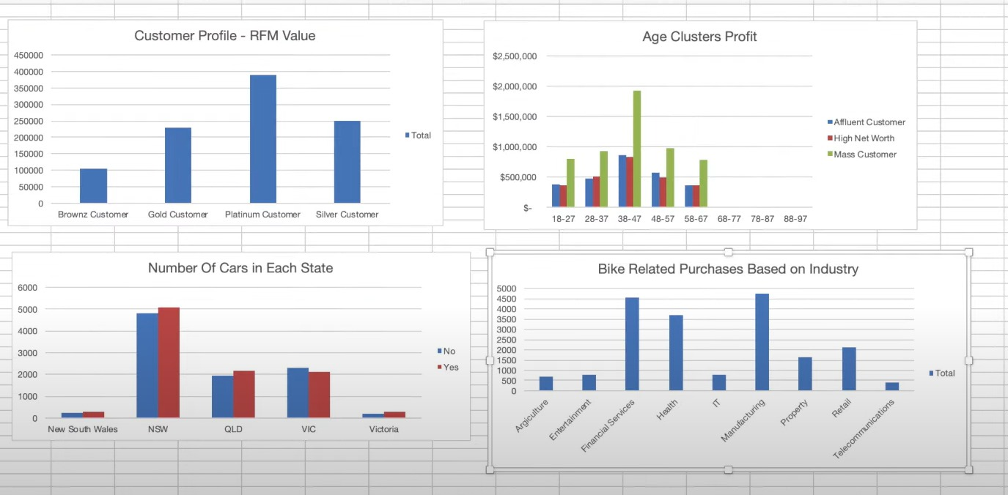
Note: The data and information in this document is reflective of a hypothetical situation and client. This document is to be used for KPMG Virtual Internship purposes only.
Data Exploration
Which Industry is contributing the most?
From the Data it is Clear that top 3 indrustries are Manufacturing, Financial and Health
Others bring profit les than 100000

Slide 5
Note: The data and information in this document is reflective of a hypothetical situation and client. This document is to be used for KPMG Virtual Internship purposes only.
Model Development
Which Customer type/status should be the main target?
Platinum value customers are the most promising buyers

Slide 6
Note: The data and information in this document is reflective of a hypothetical situation and client. This document is to be used for KPMG Virtual Internship purposes only.
Data Exploration
Which age group and wealth segment brings maximum profit?
The age group 38-47 are prominent buyers.
Overall the wealth segment of mass customers pools in the maximum profits

Slide 7
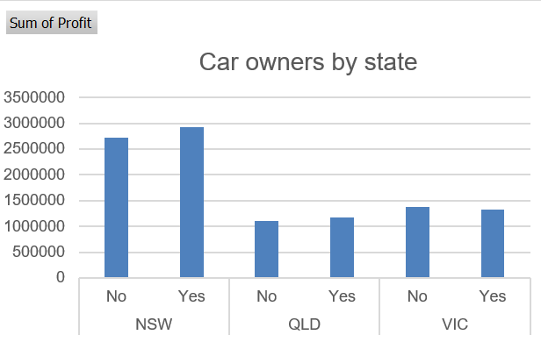
Note: The data and information in this document is reflective of a hypothetical situation and client. This document is to be used for KPMG Virtual Internship purposes only.
Data Exploration
Which State’s max Customers owns Car?
New South Wales customer owns maximum cars
Overall Customers having Cars are more likely to order produts

Slide 8
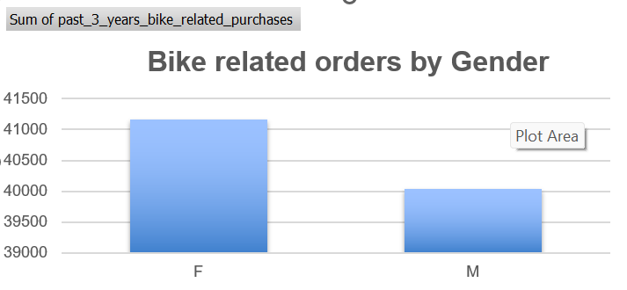
Note: The data and information in this document is reflective of a hypothetical situation and client. This document is to be used for KPMG Virtual Internship purposes only.
Data Exploration
Gender Vs Bike related sales
Data Shows that Female have made more bike related purchases than mens in past 3 years

Slide 9
Note: The data and information in this document is reflective of a hypothetical situation and client. This document is to be used for KPMG Virtual Internship purposes only.
Interpretation
Customer Classification – Targeting High Value Customers
Such customers should be targeted from new list:
Female customers are more valuable
Working in Manufacturing, Health, Finance industry sector
Aged between 38-47
Wealth segments of mass customers
Currently living in NSW, VIC and owing cars

Slide 10
Note: The data and information in this document is reflective of a hypothetical situation and client. This document is to be used for KPMG Virtual Internship purposes only.
Thank You

